Slide 1
3 suggested initial sprints
Controller
Monitor
Mechanical layout

Slide 2
Controller
Pressure
T_{i}
T_{e}
IP
External PSU
13.5v
Controller electronics
Mains power
U2
EP
time
Ti = 60/BPM/3 seconds
Te = Ti x 2 seconds
2m compressed gas line (8mm PU hose connected directly to pressure regulator)
Ptr1
SV2
TB1
CN4
PR
CN5
CN7
NC
CN9
CN15
CN8
CN10
Receives pre-blended gas
TB2
5L plastic bottle, or (better) a test lung
SV3
NC
FR1
CN13
CN11
CN12
Breadboard
FR2
EV1
Prove that the pressure wave can be reproduced
BPM 10 to 30
EP 4mbar to 20mbar
IP 4mbar to 35mbar

Slide 3
Controller – pressure wave shape
Small over-/under-shoot spikes are tolerated, but undesirable
Large and long over/-under-shots are not tolerated
3
Pressure
T_{di}
T_{de}
Pressure
2
Pressure
IP
IP
1
IP
EP
EP
EP
time
time
time
At BPM = 10: Ti = 2s
At BPM = 30: Ti = 0.7s
Tde should be as short as possible. The actual Tde depends on the lungs natural elasticity and resistance in the breathing circuit. As long as it looks reasonable sharp then the CO2 washout will happen.
3 waveform examples:
They all deliver the same amount of ‘work’ and fill the lung with an equivalent volume of gas.
#1 uses the least pressure (which is good), but the abrupt rise is faster than the lung can comply. This risk putting shear stress on the lung tissue.
#3 produces a gentler rise (which is good), but it requires a higher, shorter plateau (which is bad). Lung tissue is sensitive to pressure (barotrauma).
#2 is the best compromise. The plateau should be about 2/3 of the Ti time – meaning Tdi should be no more than 1/3 of the rise time. With the fastest Ti being 0.67s, the best fixed Tdi = 0.2s.
A plastic bottle test lung tends to be less compliant and fills more straightforwardly (compared to the intricate lung). The testing should focus on Tdi = 0.15s.
Tdi is adjusted by regulator PR, or by changing the orifice size in SV2.

Slide 4
1v
There are similarity to an electric circuit, but they are not entirely the same.
It is ok to conceptualise in the same way.
10k
~0.1v
1k
Valve
orifice
SV3
Pressure here acts on a bigger surface and it could be less than 35 mbar, but use about 50 mbar for safety margin. Do not exceed 100mbar.
1 bar
700 mbar
Flow resistive
orifice 1
Diaphragm must resist up to 35 mbar patient pressure, but acting on a smaller surface.
~50 mbar
Flow resistive
orifice 2
Ambient
(+0 mbar)

Slide 5
Monitor
T_{di}
T_{de}
IP
Visible alarm
16 segment LCD
EP
Audible alarm
History
Mute
First
SPK
time
External PSU
13.5v
Monitor electronics
U1
Patient effort creates small drop
Mains power
First:
Use a set of test data in a memory array for developing the:
Breath detection (later copied to the Controller)
Tdi and Tde calculations
Over-pressure >40mbar detection and shutdown (later copied to and repeated in Controller for duality).
Second:
Verify with an electrical simulation signal (e.g DAC from a MPU), if time permits. This provides a controlled/noise-free test signal.
Third:
Test on real breathing person (use an AMBU bag if available). This provides a normal noise environment.
Second
SV1
NC
Third
Ptr2
Breadboard
Breath onset
t_{f} = 50mS
offset
Patient circuit pressure
t_{s} = 2000mS
Breath detect
time

Slide 6
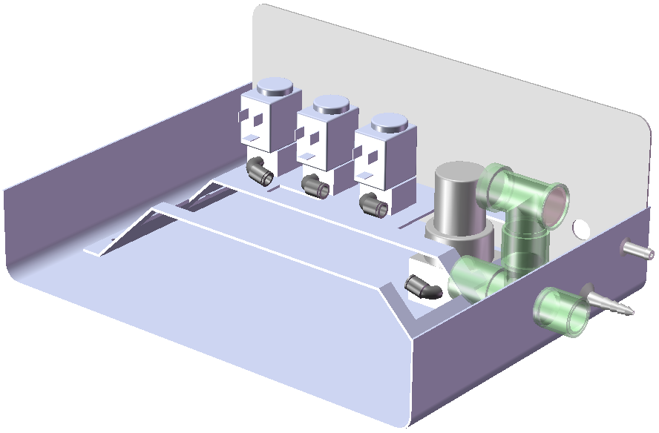
Mechanical
Identifying part and organising layout.
Design for Manufacturing.
Use rubber grommets and rubber feet to dampen the mechanical transfer of the solenoid valves’ ‘click’ noise (which are irritating and a source of anxiety in patients).

